Slide 1
Capstone Project Telecom Churn Management
By
Mohamed Munlir
DSA_0394

Slide 2
Inside …
About capstone Sources.
Data set behavior
Project structure
Exploratory Data Analysis
Preprocessing
Modal creation
Modal Improve
Conclusion

Slide 3
About capstone Sources.
In this project , the data set was taken from kaggle websites.
Following is the link to download source files from the website
https://www.kaggle.com/datasets/blastchar/telco-customer-churn
The main objective of this data modelling is to identify whether there are possibility to capture the reason for leaving customers from the network. So that through this model it can be predictable the scenarios that influence customers to churn. And the way to keep customer without churn.

Slide 4
Data set behavior
The data set is all about the churn related details in telecommunication sector.
The data contain..
7043 rows and 21 columns.
The data comprised of customer profile related details as well as usage related details.
Among the above details the “churn” of customers are highly influential feature to identify the customer behavior and the service utilizations.
Hence, Target variable indicates if a customer has left the company (i.e. churn=yes) within the last month. Since the target variable has two states (yes/no or 1/0), this is a binary classification problem
Hence , Churn is the target variable and the other features are the independent variables

Slide 5
Project structure
The project is structured as follows:
Exploratory Data Analysis
Data Preprocessing
Model Creation and Evaluation
Improving the Model

Slide 6
Data mining process
In the telco churn data set there are three data types contains in the features in that float and int data types are very few and 18 object data types available in the dataset.
Further , to obtain the data features , I took each columns’ unique features to identify, in which way the data can be scale down for my model creation .
Accordingly , there are 6 binary variables available.
When check with correlation of binary variables.
SeniorCitizen, Dependents, PhoneService, PaperlessBilling having variability.
For example , lets take “Dependents” variable , it contain “no” and “yes” data , it means that they have no dependent in their family, So it required to check how may of no- dependent have churned and vice versa.
At first glance, only customer ID seems irrelevant to customer churn. Other variables may or may not have an effect on customer churn. It is need to figure our later.
Accordingly, it was done to check correlations of each features with churn.

Slide 7
Pre-processing & feature selection
The preprocessing and feature selection are done in terms of churn, few
examples are attached herewith for a basic understanding
Binary class features
There is a high imbalance in SeniorCitizen and PhoneService variables. Most of the customers are not senior and similarly, most customers have a phone service.
Similarly, It can be checked other binary categorical features in terms of churn rate.
Average churn rate for males and females are approximately the same
gender
Female | 0.269209
Male | 0.261603

Slide 8
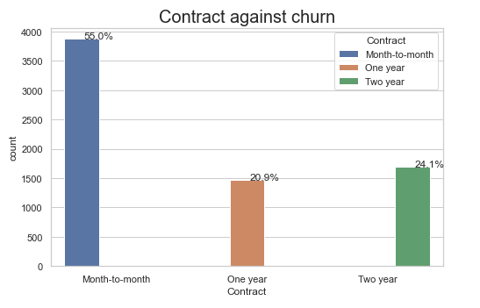
Pre-processing & feature selection
Other class features
Contract customers with short-term contract are more likely to churn. This clearly explains the motivation for companies to have long-term relationship with their customers.

Slide 9
After exploring the variables, it is required not to use following features because they add little or no informative power to the model:
Customer ID
Gender
PhoneService
Contract
TotalCharges

Slide 10
Pre-processing….
Categorical variables need to be converted into numbers and those are not ordinal. Further It is required to scale continuous variable as well because it will influence the accuracy of the model.
To do this, I have used label encoder , one-hot encoder and the min-max encoder.
After encoding done , the shape would be same as earlier ( 7043 rows.)
Resampling
When check with target variable it shows an imbalance between the data .
Hence , it is needed to up-sample the data to have equal in term of training and testing. The main objective of this up-sample is to have a high accuracy and eliminate over fitting situation

Slide 11
Model creation
In order to evaluate the performance of our model on fresh, never-before-seen samples, I must separate the dataset into training and test subsets with 20% .
Used the basic regression model to check its accuracy and the confusion matrix were in the expected level as mentioned below.
[[791 235]
[261 783]]
And obtained following accuracy levels.
Logistic Regression model has an accuracy of 76.039%
KNeighborsClassifier model has an accuracy of 77.44%
SVC model has an accuracy of 77.198%
DecisionTreeClassifier model has an accuracy of 88.889%
It can be seen that decision tree classifier having high accuracy than other model performers.
In the meanwhile the model summary was taken using statsmodels.api. As per summary , most of the features having P value of less than 0.05, that mean there are high influential to target variable of churn
Further to this , it was taken to identify the accuracy score of each sets separately . For that RidgeClassifier() and RandomForestClassifier() were used to get the out put.
Output using RidgeClassifier()
Accuracy_score for training set: 0.757
Accuracy_score for testing set: 0.761
Accuracy_score using RF for testing set: 0.804.
The random forest bring an accuracy of 80% as mentioned above for the testing but 82% for training data , 2 % is much higher than testing , hence it is required to tune up the model to get an accurate figure.

Slide 12
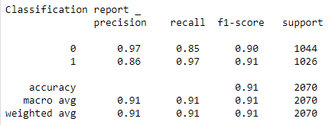
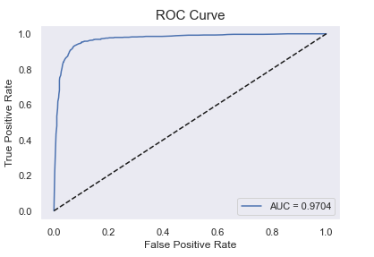
Modal Improve
To tune up the model , sklearn.model_selection import GridSearchCV was used and upgrade the n_ estimator and maximum depth . Therefore , it can be increased the accuracy upto 90% .
Finally it can be seen that the RandomForestClassifier is the best algorithm in this model and it reveal about 91% of the accuracy as follows
Through out the ROC curve result , it can be also identified that the data set is up to the expected level and it revealed of 97% and the curve is inline with the graph.

Slide 13
Conclusion
In conclusion , it can be achieved an overall accuracy of almost 90%. This is the mean cross-validated score of the best_estimator. In the previous random forest, the mean score was approximately 86% (88% on training and 84% on test). Using GridSearchCV, it is improved the model accuracy by 4%.
Finally , the telecom churn data represent that , there is a predictable way to identify how to keep customers from churn.

Slide 14
Thanks

